Slide 1


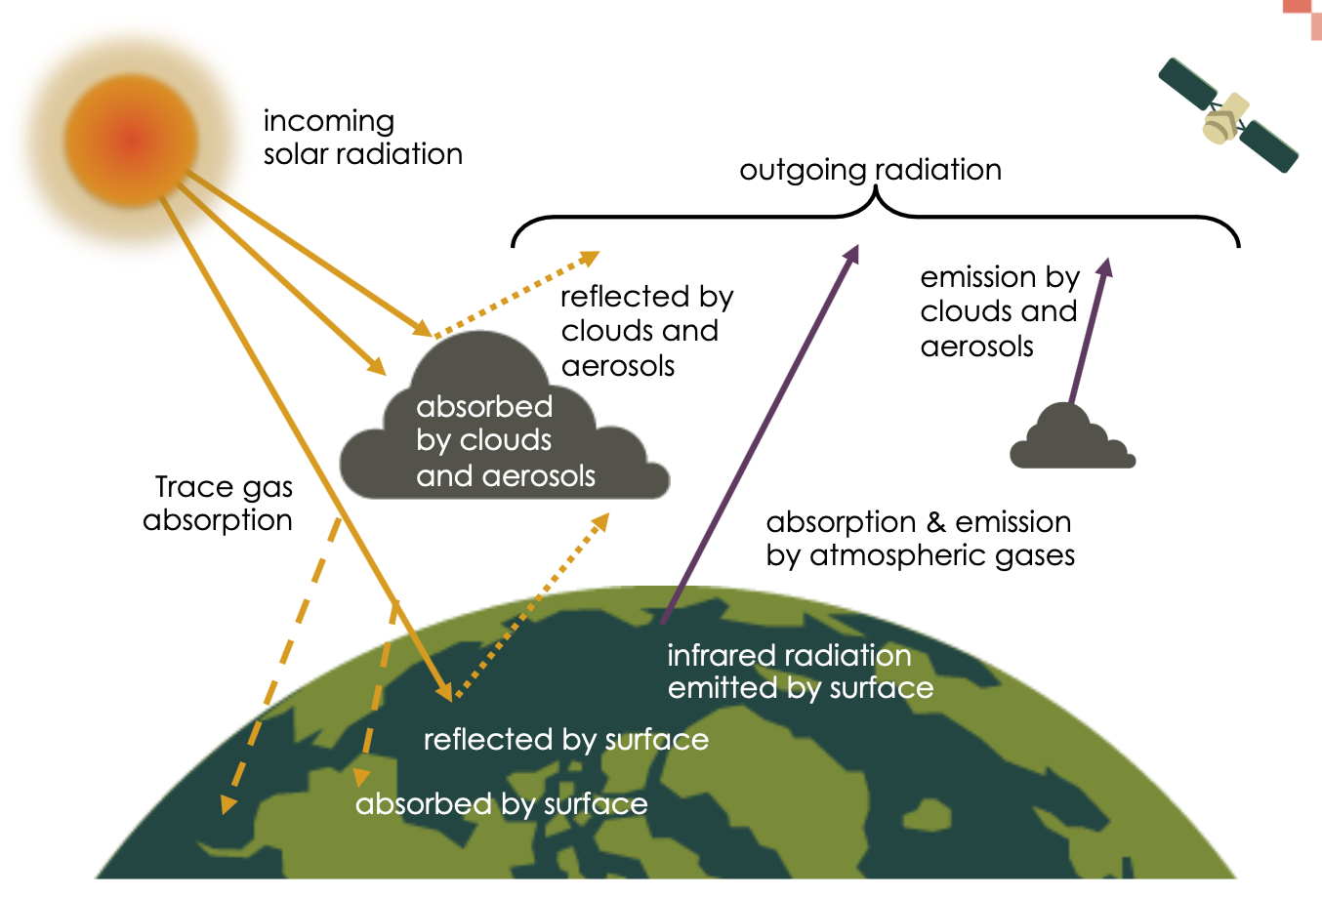
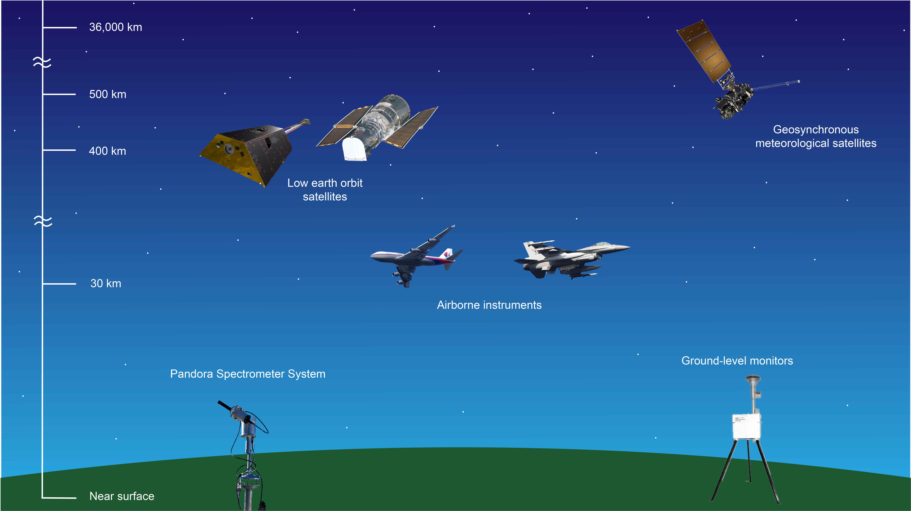
Quick Guide: Comparing Satellite NO₂ versus Ground Level Measurements
How does satellite NO₂ data differ from ground monitor data?
Column measurements are obtained from remote-sensing instruments (e.g., satellites looking down on the Earth or ground-based spectrometers such as Pandoras) that measure light transmitted through layers of the atmosphere. When NO₂ is present in an atmospheric column, it absorbs light at specific wavelengths, enabling concentrations to be inferred from the measured radiation.
Ground level measurements are taken at the surface, with ground-level in situ monitors, low-cost sensors, mobile monitors, etc.
Column measurements thus may not directly track concentrations near the Earth’s surface but satellite data offer wider spatial coverage than is possible with ground-based instruments.
Satellite instruments measure reflected and emitted radiation to space. Image credit: NASA ARSET
What are the measurements for surface level data versus satellite column data for gases?
Ground-level instruments measure concentrations at a single location, often reported in mixing ratio units of parts per billion (ppb)
Satellite data for gas species (for example, NO₂) are column concentrations, often provided in moles/m² or molecules/cm², also called vertical column density (VCD)
Geostationary satellites (like TEMPO), low earth orbit satellites (TROPOMI and OMI) provide column measurements looking down from space. Pandoras provide column measurements looking up from Earth. Ground monitors provide surface concentrations at the point of measurement. Image adapted from NASA ARSET
NASA's Health and Air Quality Applied Sciences Team
Adapted from ARSET trainings Fundamentals of Remote Sensing and An Inside Look at How NASA Measures Air Pollution, and Holloway and Bratburd (2022) “The Four Things to Know about Satellite Data for Air Quality Management.” EM Magazine
1

Slide 2
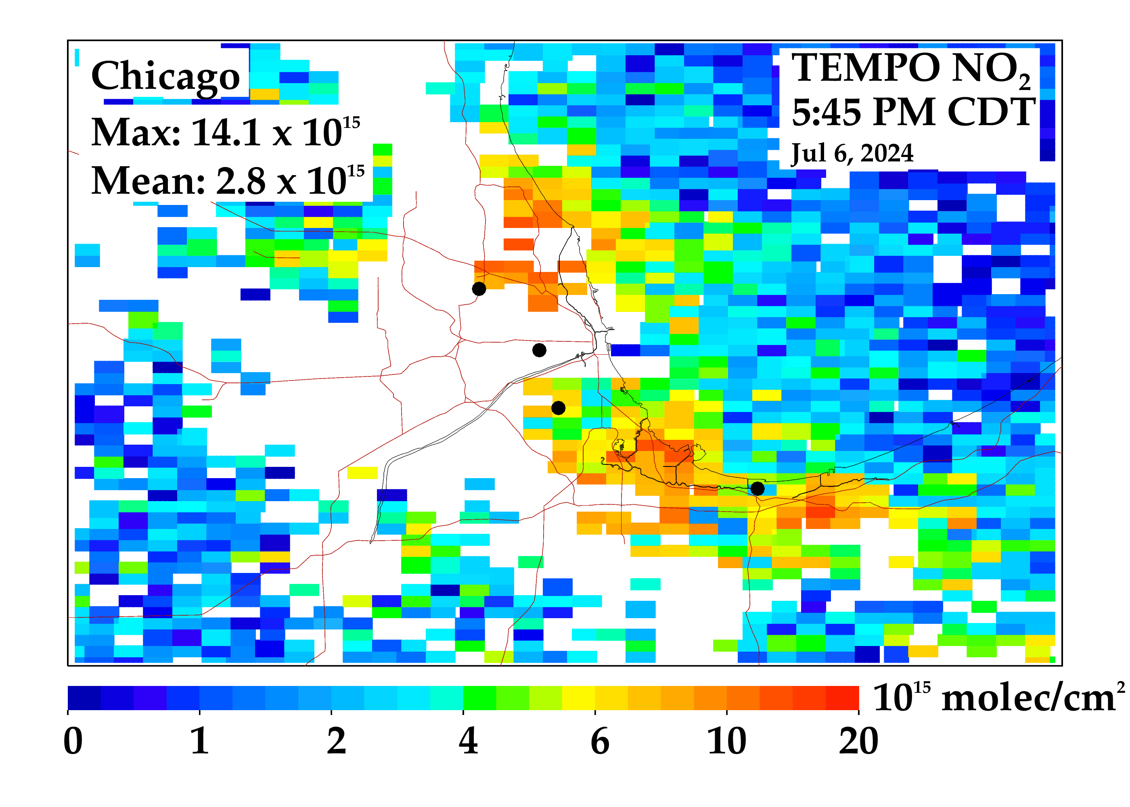
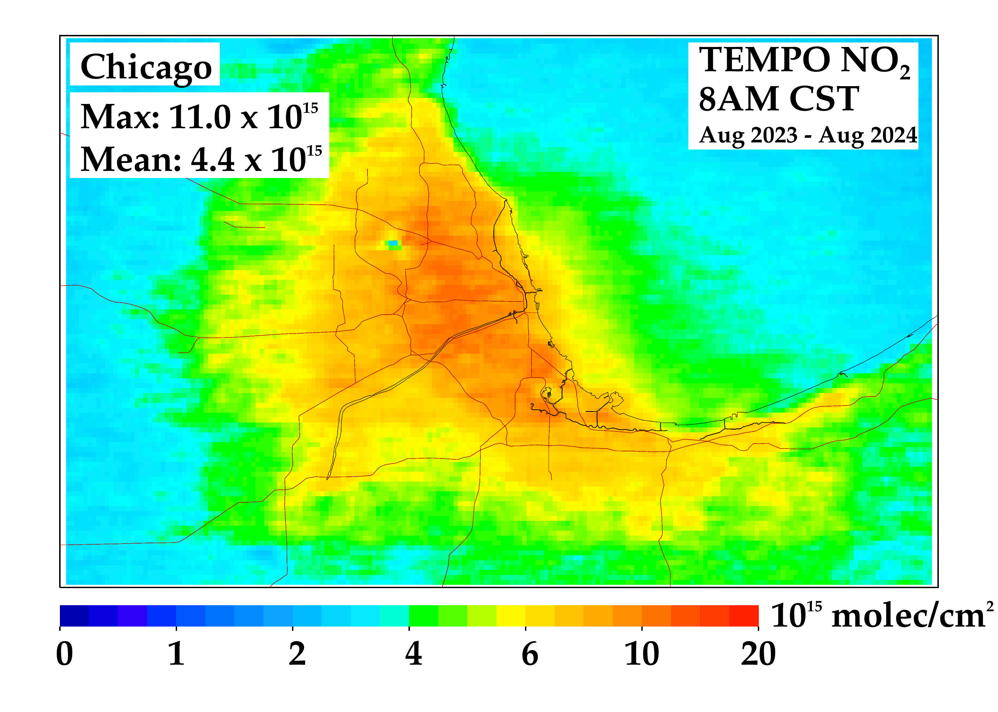
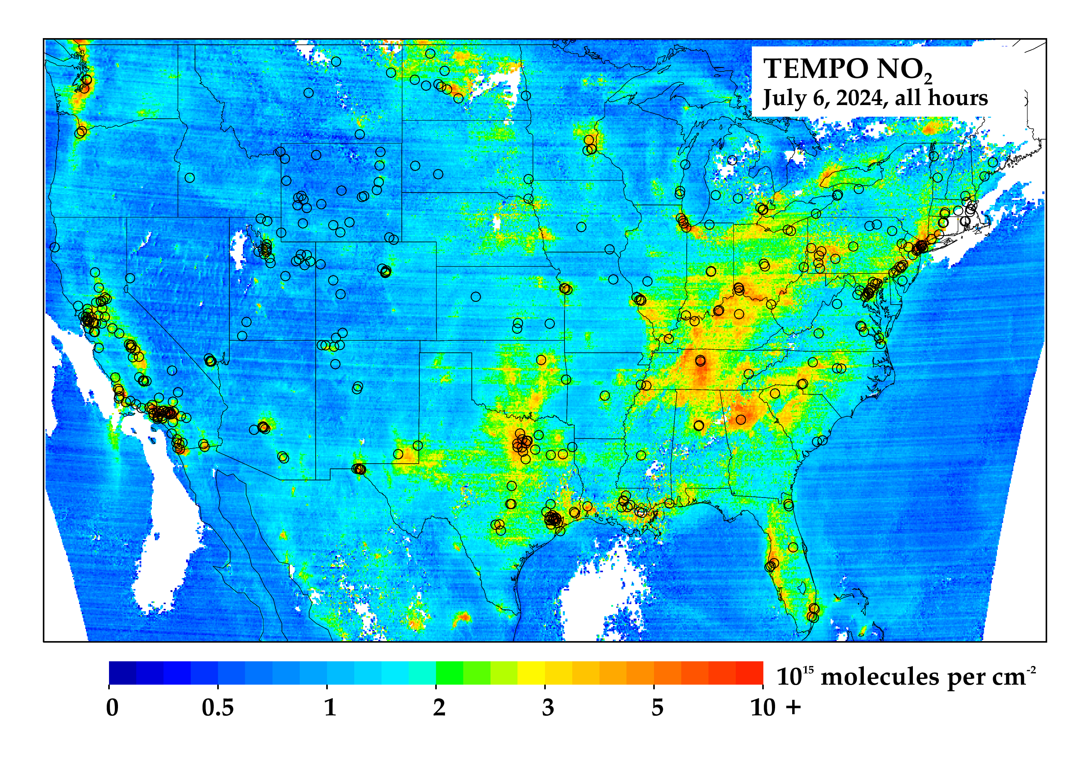
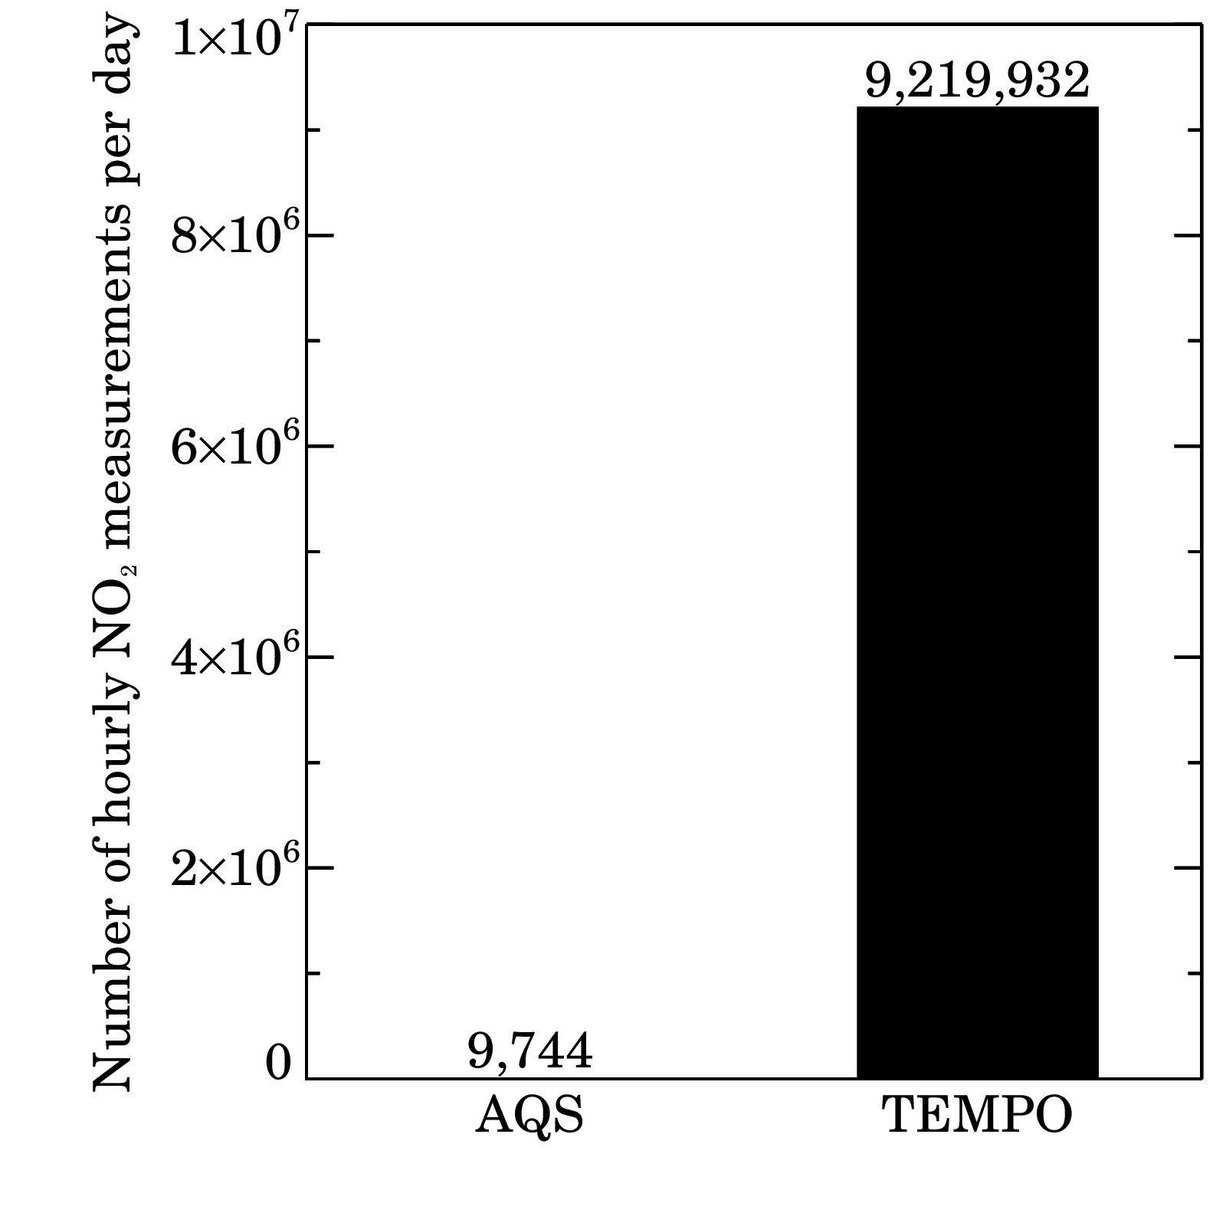
Quick Guide: Comparing Satellite NO₂ versus Ground Level Measurements
TEMPO NO₂ hourly vs daily vs. annual
How can satellite data be transformed to compare with ground level data?
Calculations are needed to translate raw satellite data information reported by the instrument into a satellite data product. These data products are called “retrievals”, and need to use some assumptions from chemical transport models.
Studies have found that satellite data spatial and temporal patterns of NO₂ resemble those measured by ground-based monitors because most tropospheric column NO₂ resides near the Earth’s surface and its lifetime is sufficiently short that spatial patterns largely reflect nearby sources.
NO₂ trends measured from the ground often resemble those from space.
Data fusion combines satellite data, model data, ground-level monitoring.
TEMPO NO₂ hourly on an annual basis
NASA ARSET Trainings
Fundamentals of Remote Sensing
An Inside Look at How NASA Measures Air Pollution
NASA Atmospheric Composition Ground Networks Supporting Air Quality and Climate Applications
Resources
Example Publications
Goldberg et al. (2024) Evaluating spatial patterns of U.S. urban NOx emissions using TROPOMI NO₂
Kim et al. (2024) A Comparison of Regression Methods for Inferring Near-Surface NO₂ with Satellite Data
Duncan et al. (2014) “Satellite data of atmospheric pollution for U.S. air quality applications: Examples of applications, summary of data end-user resources, answers to FAQs, and common mistakes to avoid”
NASA's Health and Air Quality Applied Sciences Team
2

